Slide 1
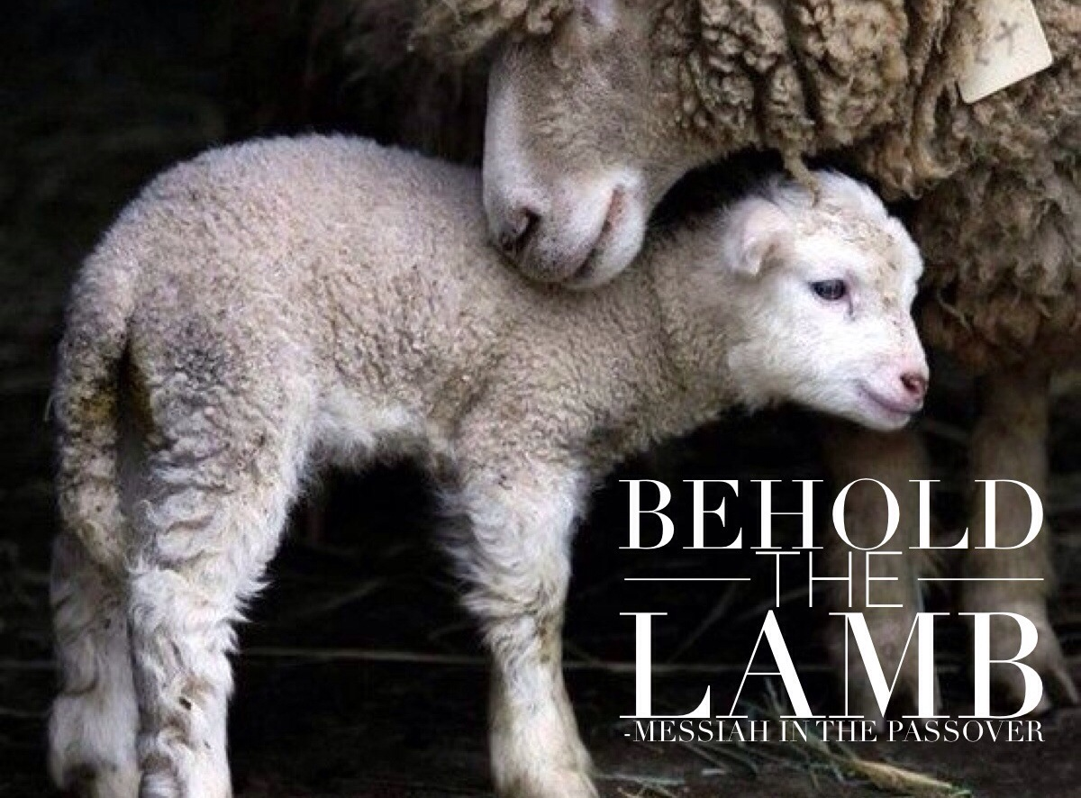

Slide 2
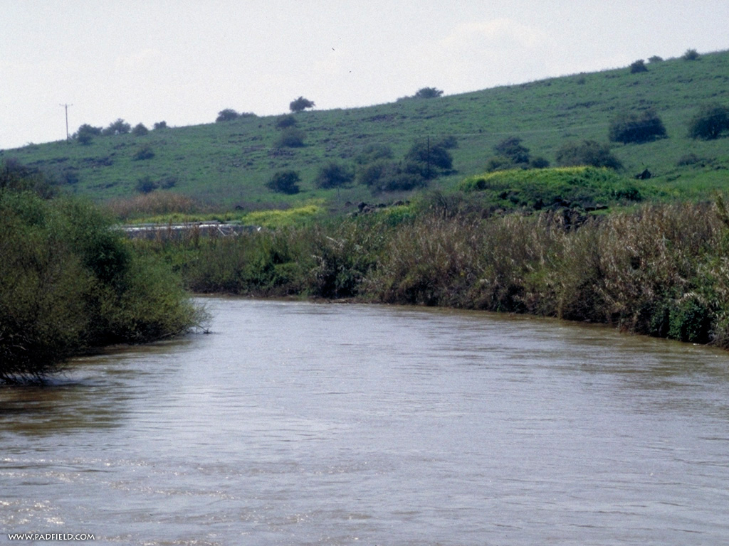
The next day John saw Jesus coming toward him and said, "Look, the Lamb of God, who takes away the sin of the world! John 1:29

Slide 3
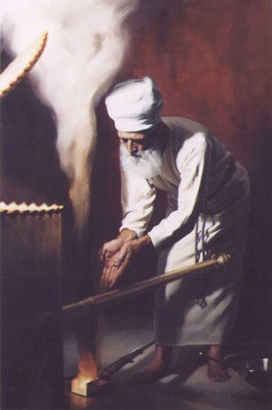
What was John’s background?
He wasn’t Baptist…
He was the son of a priest
He was a radically observant Jew!
He knew all about the Scriptural, and traditional customs of Passover and was drawing a direct parallel.
In order for us to truly understand what John was meaning, we have to understand the Passover of the LORD!
We need the shadows to bring depth to the reality of redemption that was accomplished through Yeshua!
Notes:
Shadows bring dimmensions

Slide 4
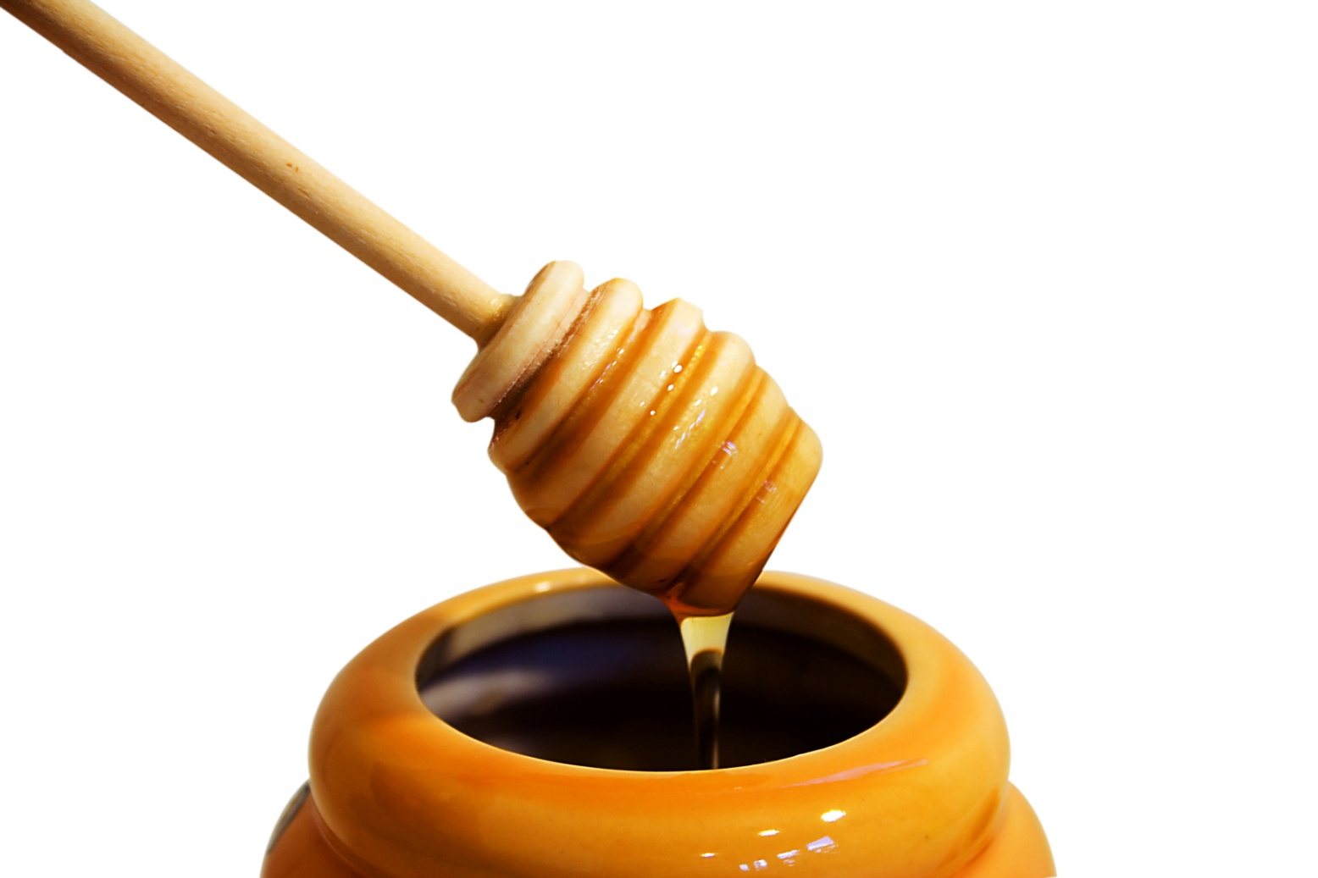
A Challenge to those who love God’s WORD:
Some of God’s Word is like honey…
We read it and immediately understand what it says
It is sweet to us, at the first taste
It is easy to palette and digest

Slide 5
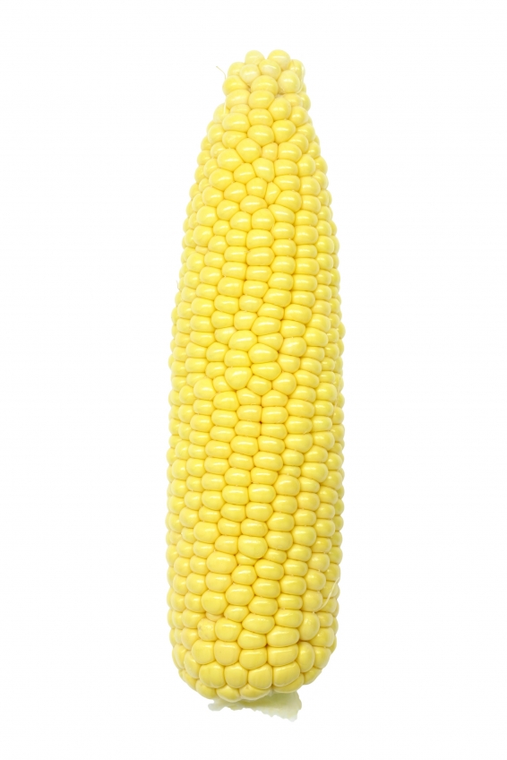
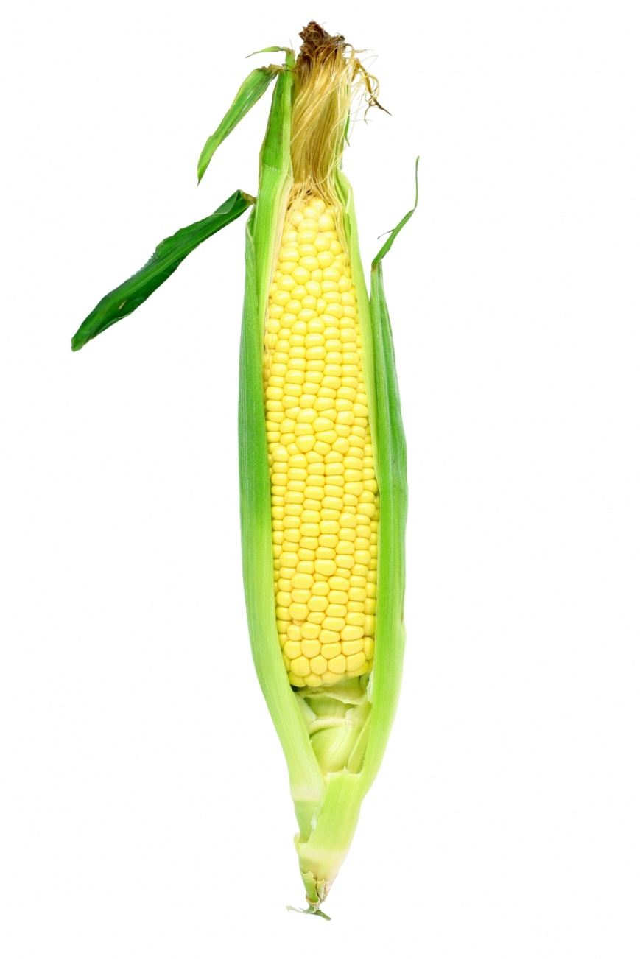
Then, we get to more difficult passages of Scripture, and we see that there are husks all around the part we are supposed to eat.
I propose that we need to peel back
The husks of time
The husks of culture
The husks of language
The husks of context
And the husks of our finite mind!

Slide 6
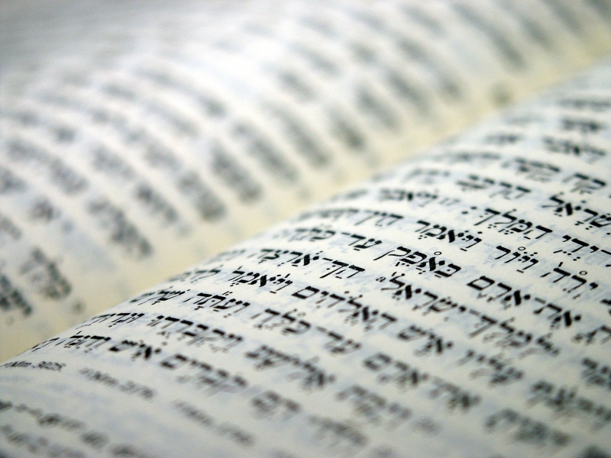
Don’t chuck it, shuck it!

Slide 7
The Scriptures, both the OT and NT Scriptures, are verbally inspired of God and are the revelation of God to man, the infallible, authoritative rule of faith and conduct.
2 Timothy 3:15-17 (New International Version)
15and how from infancy you have known the holy Scriptures, which are able to make you wise for salvation through faith in Messiah Yeshua. 16 All Scripture is God-breathed and is useful for teaching, rebuking, correcting and training in righteousness, 17so that the man of God may be thoroughly equipped for every good work.
Notes:
This is a fundamental truth!!!
Story of witch who contacted us before our Grand Opening service and didn’t want to participate because we held

Slide 8
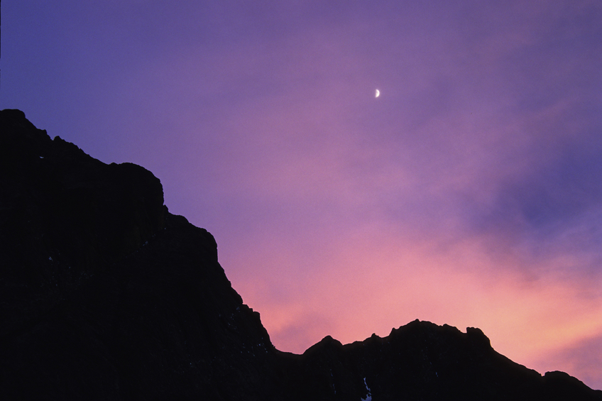
Leviticus 23
1 The LORD said to Moses, 2 "Speak to the Israelites and say to them: 'These are my appointed feasts, the appointed feasts of the LORD, which you are to proclaim as sacred assemblies.
Appointed feasts, holy convocations
קדשׁ מקרא- mikrah kodesh
A holy gathering, or holy rehearsal!
Notes:
Explain how everything in the Torah, the first five books of Moses, and the Tenach.. The OT was a type and shadow
Of the feasts.. It was a holy rehearsal of things to come!
Wedding rehearsal the night before the wedding
The bride has to know what she’s going to do.

Slide 9
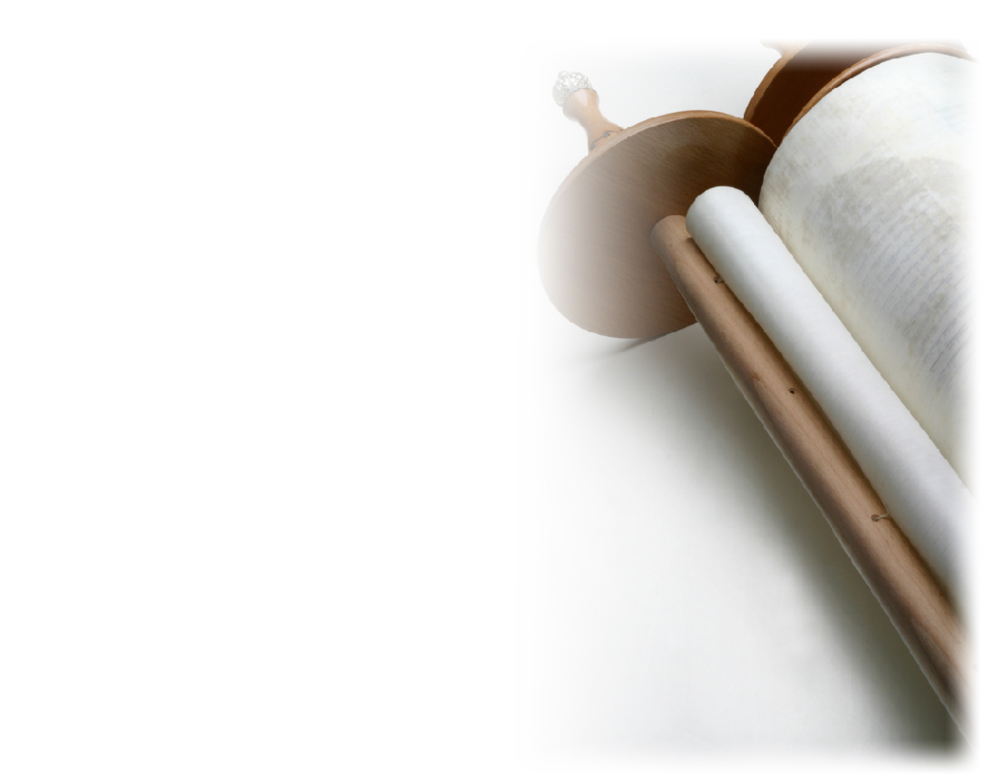
Leviticus 23: 4-8
4 " 'These are the LORD's appointed feasts, the sacred assemblies you are to proclaim at their appointed times:
5 The LORD's Passover begins at twilight on the fourteenth day of the first month. 6 On the fifteenth day of that month the LORD's Feast of Unleavened Bread begins; for seven days you must eat bread made without yeast.
7 On the first day hold a sacred assembly and do no regular work. 8 For seven days present an offering made to the LORD by fire. And on the seventh day hold a sacred assembly and do no regular work.' "
Notes:
Feasts are key elements for the Jewish people
Explain the calendar and how people would relate life to the feasts.

Slide 10
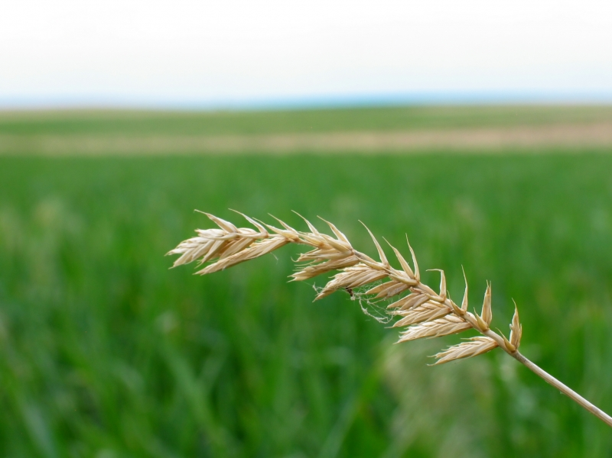
The first month of the Biblical calendar is the month of Aviv, also known as Nisan.
Notes:
Civil and Biblical Calendars
The first month on the Biblical calendar is Abib or Nisan (not the car you drive)
Come with me to the book of Exodus chpater 12.

Slide 11
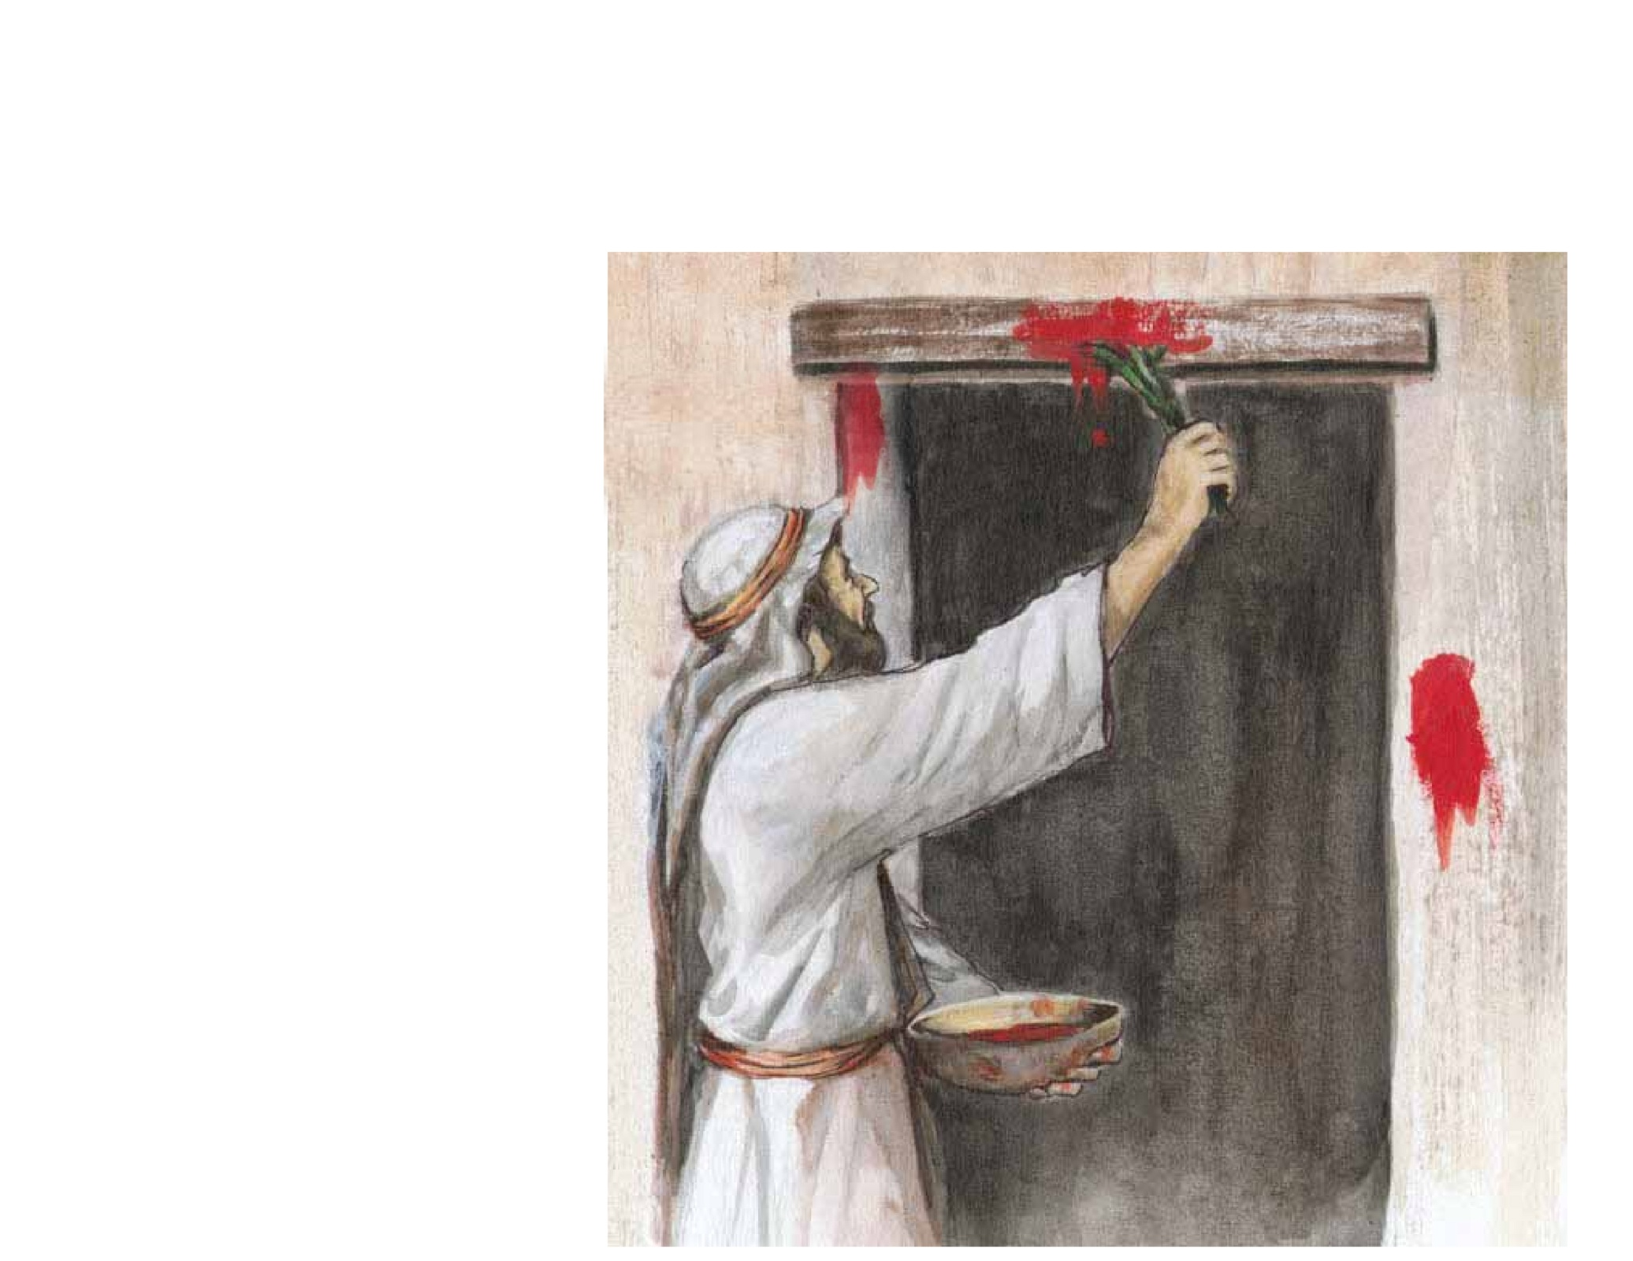
Exodus 12:1 (NIV)
1 The LORD said to Moses and Aaron in Egypt, 2 "This month is to be for you the first month, the first month of your year. 3 Tell the whole community of Israel that on the tenth day of this month each man is to take a lamb for his family, one for each household.

Slide 12
The feast was required for all men to celebrate. It didn’t exclude the rich or the poor. It called for everyone to keep the feast and everyone was to take a lamb.

Slide 13
John recognized Yeshua as the Lamb of God, a lamb that everyone needed.
Romans 3:23 “ for all have sinned and fall short of the glory of God,”
Romans 3:10 "There is no one righteous, not even one;”
Some think that they have been good enough.
Acts 4:12 Salvation is found in no one else, for there is no other name under heaven given to men by which we must be saved."
Everyone needs the Lamb!
Notes:
The feast was required for all men to celebrate. It didn’t exclude the rich or the poor. It called for everyone to keep the feast and everyone was to take a lamb.
Relate this back to John. He recognized Jesus as the Lamb of God, a lamb that everyone needed. For all have sinned and fall short of the glory of God. There is no one righteous no not one.
Some think that they have been good enough.
There is one name under heaven in which one may be saved.
Everyone needs The Lamb.
Everyone needs to deal personally with the question of, have you entered into a personal relationship with Jesus.
Lets go back to our main passage of Scripture Exodus 12, let’s pick up in verse 5

Slide 14
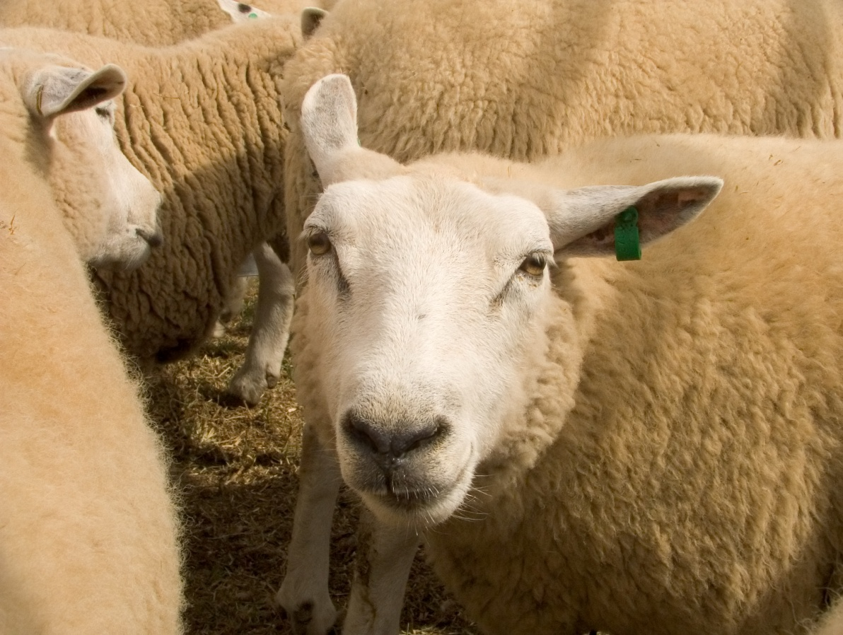
Qualifications for the Passover Lamb
Exodus 12
5 The animals you choose must be year-old males without defect, …
The lamb was to be one year old, in the prime of life, without blemish.
2 Corinthians 5:21, “God made him who had no sin to be sin for us, so that in him we might become the righteousness of God.”
Notes:
Exodus 12:6… click to next slide

Slide 15
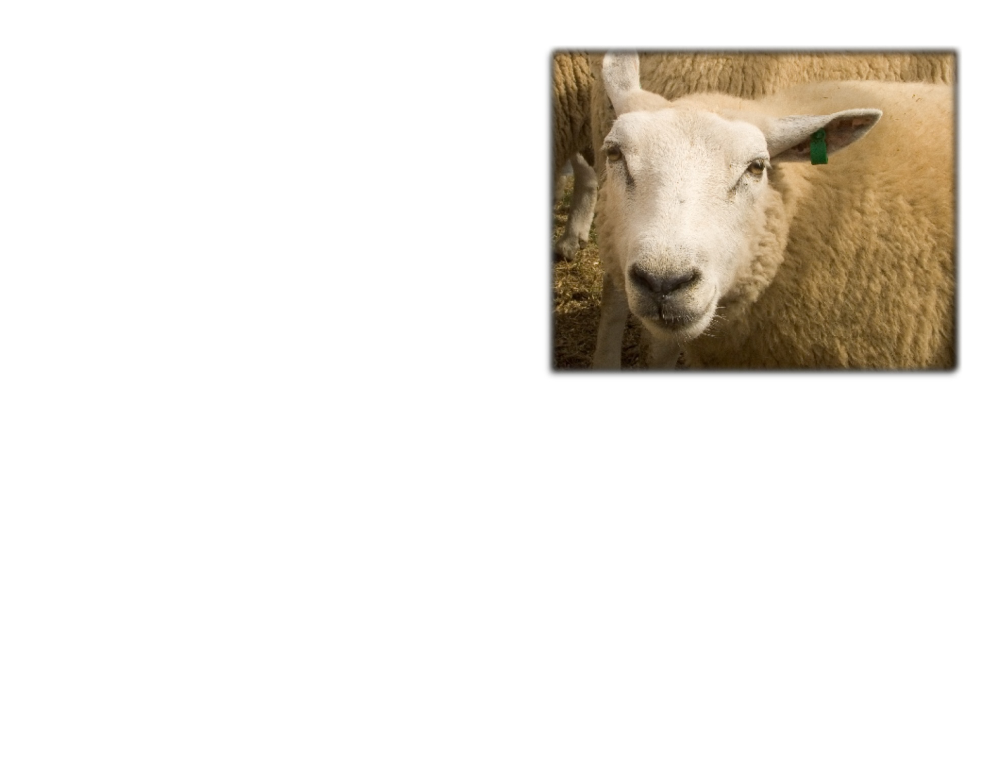
What time was the lamb to be killed?
6 Take care of them until the fourteenth day of the month, when all the people of the community of Israel must slaughter them at twilight. Ex 12
When was this?
This was a time between 12 and 6p.m.
The time they were to sacrifice the Passover lamb was at 3:00 in the afternoon!
What time did Yeshua complete our Passover atonement?
44 It was now about the sixth hour, and darkness came over the whole land until the ninth hour, 45for the sun stopped shining. And the curtain of the temple was torn in two. 46Yeshua (Jesus) called out with a loud voice, "Father, into your hands I commit my spirit." When he had said this, he breathed his last. Luke 23:44-46
Notes:
Exodus 12:12

Slide 16

The blood was placed on the doorposts of the home
Exodus 12
12 "On that same night I will pass through Egypt and strike down every firstborn—both men and animals—and I will bring judgment on all the gods of Egypt. I am the LORD. 13 The blood will be a sign for you on the houses where you are; and when I see the blood, I will pass over you. No destructive plague will touch you when I strike Egypt.

Slide 17
Why was the blood placed on the doorposts of the home?
So that the people might be saved from death.
    Heb 10:1 For the law having a shadow of good things to come, and not the very image of the things, can never with those sacrifices which they offered year by year continually make the comers thereunto perfect.

Slide 18
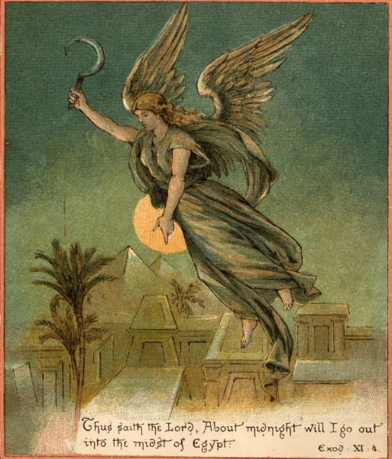
What was this a shadow of?
God’s judgment on the world Rev 20:12-15
The plague of eternal death Matthew 25: 41-46
Salvation only through the Lamb of God Rev 7:14
The necessity of the blood of the Lamb to be placed on the doorposts and lintels of our hearts. Rev 12:11
The free gift of eternal life through the salvation of the LORD. Rom 6:23

Slide 19
John 3:36
Whoever believes in the Son
has eternal life,
but whoever rejects the Son
will not see life,
for God's wrath remains on him."

Slide 20
    John 5:24
    Verily, verily, I say unto you, He that heareth my word,
    and believeth on him that sent me, hath everlasting life,
    and shall not come into condemnation;
    but is passed from death unto life.
Notes:
Exodus 12:8… click to next slide

Slide 21
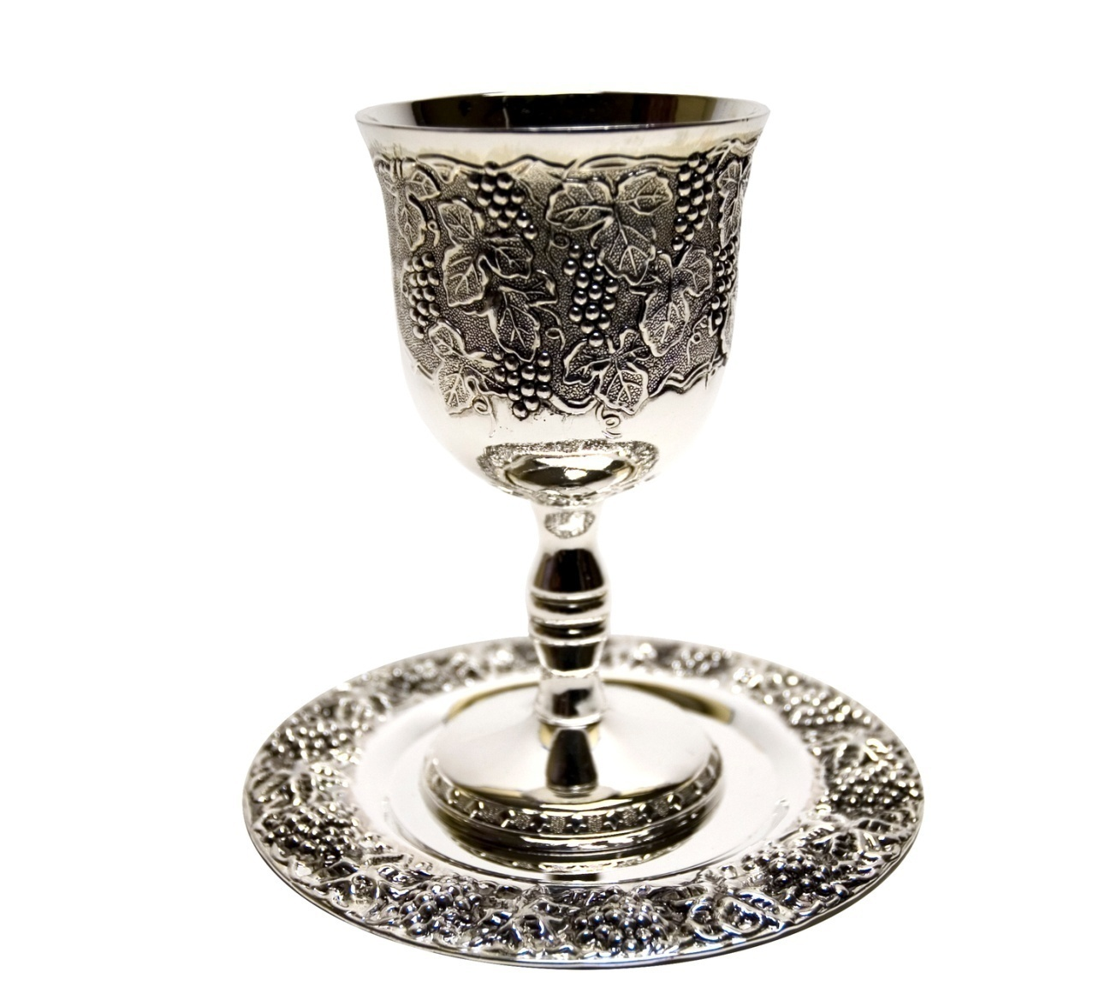
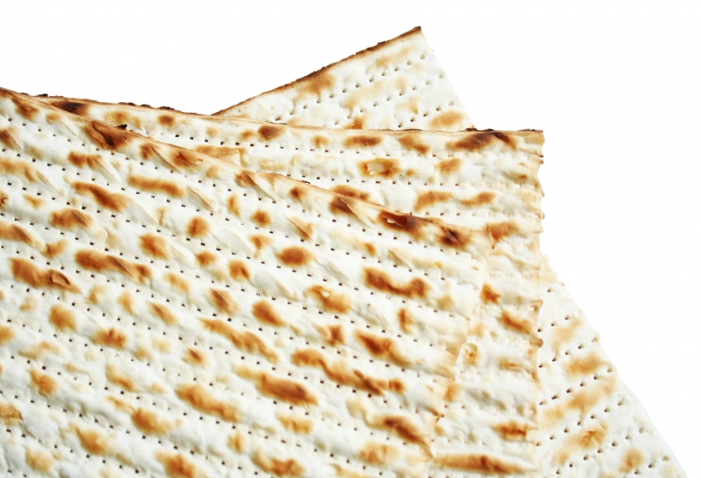
Exodus 12:8
That same night they are to eat the meat roasted over the fire, along with bitter herbs, and bread made without yeast.
Notes:
Describe the significance of the bread without leaven.

Slide 22
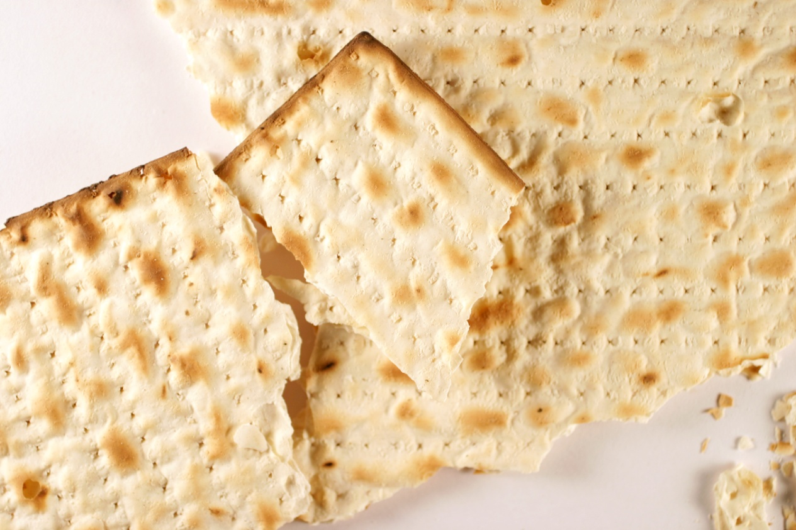
The Matzah- Or Unleavened Bread
1 Corinthians 5:6-8 Your boasting is not good. Don't you know that a little yeast works through the whole batch of dough?
7Get rid of the old yeast that you may be a new batch without yeast—as you really are. For Messiah (Christ), our Passover lamb, has been sacrificed.
8Therefore let us keep the Festival, not with the old yeast, the yeast of malice and wickedness, but with bread without yeast, the bread of sincerity and truth.

Slide 23
The Matzah- Or Unleavened Bread
Notice how the matzah has piercings through it?
See how, because of the way it is baked, it is striped?
Isaiah 53:5 (KJV)
5But he was wounded (or pierced) for our transgressions, he was bruised for our iniquities: the chastisement of our peace was upon him; and with his stripes we are healed.

Slide 24

The Cup of Proposal and Redemption
27 Then he took the cup, gave thanks and offered it to them, saying, "Drink from it, all of you.
28 This is my blood of the covenant, which is poured out for many for the forgiveness of sins.
29 I tell you, I will not drink of this fruit of the vine from now on until that day when I drink it anew with you in my Father's kingdom."
Matthew 26:27-29
Notes:
Jewish man places cup before young woman to propose- tell a quick story of our engagement
I will not drink…
I go to prepare a place…
Only the Father knows…

Slide 25
The Cup of Proposal and Redemption
39Going a little farther, he fell with his face to the ground and prayed, "My Father, if it is possible, may this cup be taken from me. Yet not as I will, but as you will."
Matthew 26:39
What was the dowry price for His bride?
His life!
Notes:
The church has a lot of work to do in order to make right the last 2,000 years of history. Anti Semitism, violence, hatred, persecution.
We need to do more than just provoke the Jews, we need to provoke them to jealousy as Paul says in Romans.
We must be a light to the Jewish people as well as a light to the Gentiles
For nearly 2,000 years the church has made a proclamation… You killed Christ!
Imagine being a Jewish boy or girl in New York having your own peers spit on you and tell you that, they had been told by their parents, that the Jews killed Jesus.
Who was it that killed Jesus? Was it the Jews? Was it the Romans? No. He laid down his life willingly. It was the dowry he needed to pay for His bride. Our sins are the reason for the death of Jesus.
Not any people group. It was a necessary atonement needed for the restoration between us and Father.

Slide 26
The Cup of Proposal and Redemption
During the Passover Seder we drink four cups:
Exodus 6:6-7
Sanctification
Deliverance
Redemption
Hope (or Completion)

Slide 27

Exodus 12:12-13
12 "On that same night I will pass through Egypt and strike down every firstborn—both men and animals—and I will bring judgment on all the gods of Egypt. I am the LORD.
13 The blood will be a sign for you on the houses where you are; and when I see the blood, I will pass over you. No destructive plague will touch you when I strike Egypt.

Slide 28
What saved the people?
It was the blood of the lamb on the doorposts of their homes.
What makes Yeshua’s blood powerful enough to be the final and ultimate atonement?
Notes:
Come with me to the book of Hebrews chapter 9

Slide 29
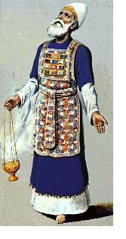
Hebrews 9:1-14
12 He did not enter by means of the blood of goats and calves; but he entered the Most Holy Place once for all by his own blood, having obtained eternal redemption.
13 The blood of goats and bulls and the ashes of a heifer sprinkled on those who are ceremonially unclean sanctify them so that they are outwardly clean.
14 How much more, then, will the blood of Christ, who through the eternal Spirit offered himself unblemished to God, cleanse our consciences from acts that lead to death, so that we may serve the living God!
Notes:
Let’s go back to Exodus 12:46-47

Slide 30
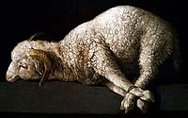
46 "It must be eaten inside one house; take none of the meat outside the house. Do not break any of the bones.
47 The whole community of Israel must celebrate it.
Exodus 12:46-47
Notes:
Let’s turn to John 19, starting in verse 31

Slide 31
John 19:31-37
31Now it was the day of Preparation, and the next day was to be a special Sabbath. Because the Jews did not want the bodies left on the crosses during the Sabbath, they asked Pilate to have the legs broken and the bodies taken down.
32The soldiers therefore came and broke the legs of the first man who had been crucified with Jesus, and then those of the other. 33But when they came to Jesus and found that he was already dead, they did not break his legs.

Slide 32
34Instead, one of the soldiers pierced Jesus' side with a spear, bringing a sudden flow of blood and water. 35The man who saw it has given testimony, and his testimony is true. He knows that he tells the truth, and he testifies so that you also may believe.
36These things happened so that the scripture would be fulfilled: "Not one of his bones will be broken," 37and, as another scripbture says, "They will look on the one they have pierced.“ John 19:31-37

Slide 33

The Afikomen is symbolic of Yeshua’s burial and resurrection!
Notes:
The Afikomen is the center of three matzos used during the traditional Passover Seder.
The three matzot can represent
Abraham, Isaac and Jacob. Why is Isaac broken?
The priests, the Levites and Israel
We know it to represent the Son, Yeshua who was broken for our sins.
It is taken out, broken in half, and half of it is hidden, and then searched for at a later time by the children.
It is the dessert, the last item that we eat during the Seder. It isn’t particularly delicious, it is the bread of affliction. It is a very spiritual food!
So too, just as the Afikomen was hidden, and then found, Messiah Yeshua was hidden in a grave for three days, and resurrected from the dead!

Slide 34
This is the season that we celebrate our
Atonement- through the blood of the Lamb
Our Life- through the Unleavened Bread
Our engagement- through the proposal cup of Redemption
Our death and resurrection with Messiah!
3Or don't you know that all of us who were baptized into Messiah Yeshua were baptized into his death? 4We were therefore buried with him through baptism into death in order that, just as Messiah was raised from the dead through the glory of the Father, we too may live a new life.
5If we have been united with him like this in his death, we will certainly also be united with him in his resurrection.
Romans 6:3-5
Notes:
*Maybe you are here and you realize that you haven’t received atonement
Maybe you are here and you are realizing that you have never received life in abundance that is offered through the sinless body of Yeshua, Jesus.
Or maybe you have never accepted the greatest love and proposal of all time?
And it is possible that you have never experienced the death of your flesh, and the resurrection of a new creation that is available only through Messiah, Jesus.
Everyone needs The Lamb who takes away the sin of the world.
Today is the day of salvation!!!….. Pastor….

Slide 35
    Rev 5:11 And I beheld, and I heard the voice of many angels round about the throne and the beasts and the elders: and the number of them was ten thousand times ten thousand, and thousands of thousands;
    Rev 5:12 Saying with a loud voice, Worthy is the Lamb that was slain to receive power, and riches, and wisdom, and strength, and honour, and glory, and blessing.
    Rev 5:13 And every creature which is in heaven, and on the earth, and under the earth, and such as are in the sea, and all that are in them, heard I saying, Blessing, and honour, and glory, and power, be unto him that sitteth upon the throne, and unto the Lamb for ever and ever.
    Rev 5:14 And the four beasts said, Amen. And the four and twenty elders fell down and worshipped him that liveth for ever and ever.

